Slide 1
Adapting H.P. Lovecraft for the screen
Making strange

Slide 2
The Out of Place and the Out of Time: Lovecraft and the Weird.
Mark fisheR
‘The Thing overwhelms, it cannot be contained, but it fascinates’ (2016:17).
‘Lovecraft’s stories are obsessively fixated on the question of the outside: an outside that breaks through in encounters with anomalous entities from the deep past, in altered states of consciousness, in bizarre twists in the structure of time. The encounter with the outside often ends in breakdown and psychosis. Lovecraft’s stories frequently involve a catastrophic integration of the outside into an interior that is retrospectively revealed to be a delusive envelope, a sham’ (2016: 16). in The Weird and the Eerie. 2016. Repeater Books. London.

Slide 3
Directing
Ryan MACKFALL
Inspiration & Origin
Why ‘The Picture In The House’?
Massachusetts & Lovecraft Country

Slide 4
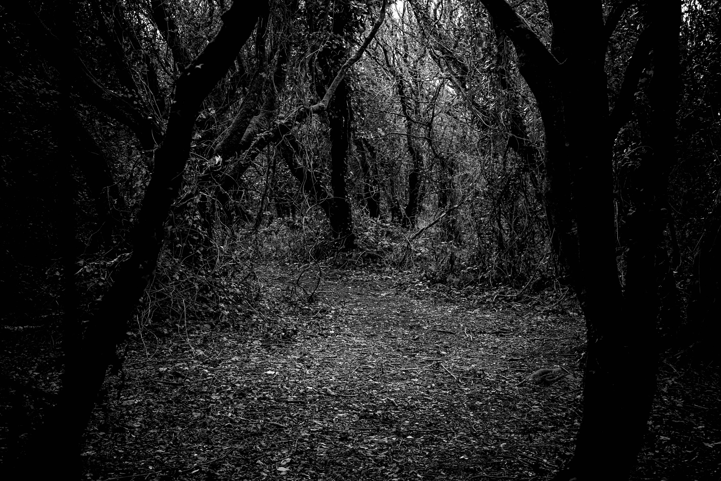

Slide 5
Screenwriting
Neil fox
Breaking Down the original story ‘The Picture In The House’
The Title Change
Language
Drafts - Dialogue
The Ending

Slide 7
Dialogue Example - First Draft
Final Scene / Final Draft
Dialogue Example - Draft Two

Slide 8
Directing
Ryan MACKFALL
Adapting ‘The Old Man’ for the screen
Logistical changes when adapting

Slide 9
Book design & illustration
Angela annesley
Collaboration & Process
Narrative Illustration
Research
Poster

Slide 11
